Slide 1
1
FUNCTIONS AND LIMITS
.

Slide 2
Limits Involving Infinity
1.6
.

Slide 3
Infinite Limits

Slide 4
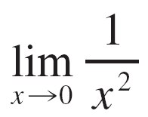
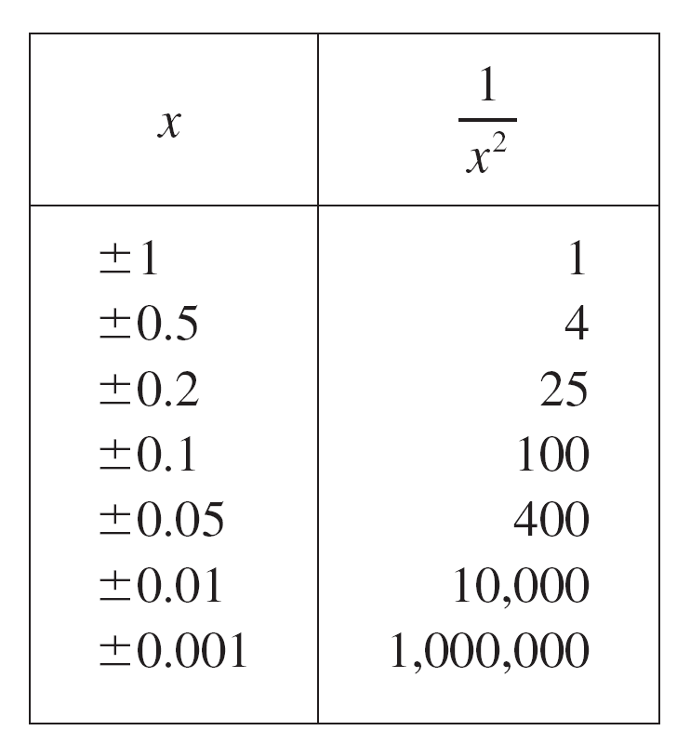
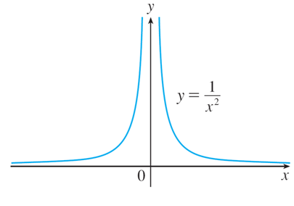
Infinite Limits
We have concluded that
does not exist
by observing, from the table of values and the graph of y = 1/x² in Figure 1, that the values of 1/x² can be made arbitrarily large by taking x close enough to 0.
Figure 1

Slide 5

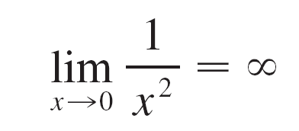

Infinite Limits
Thus the values of f(x) do not approach a number, so does not exist.
To indicate this kind of behavior we use the notation
This does not mean that we are regarding as a number. Nor does it mean that the limit exists.

Slide 6
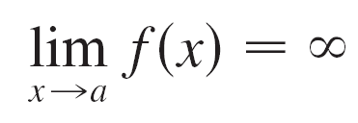
Infinite Limits
It simply expresses the particular way in which the limit does not exist: 1/x ² can be made as large as we like by taking x close enough to 0.
In general, we write symbolically
to indicate that the values of f(x) become larger and larger (or “increase without bound”) as x approaches a.

Slide 7
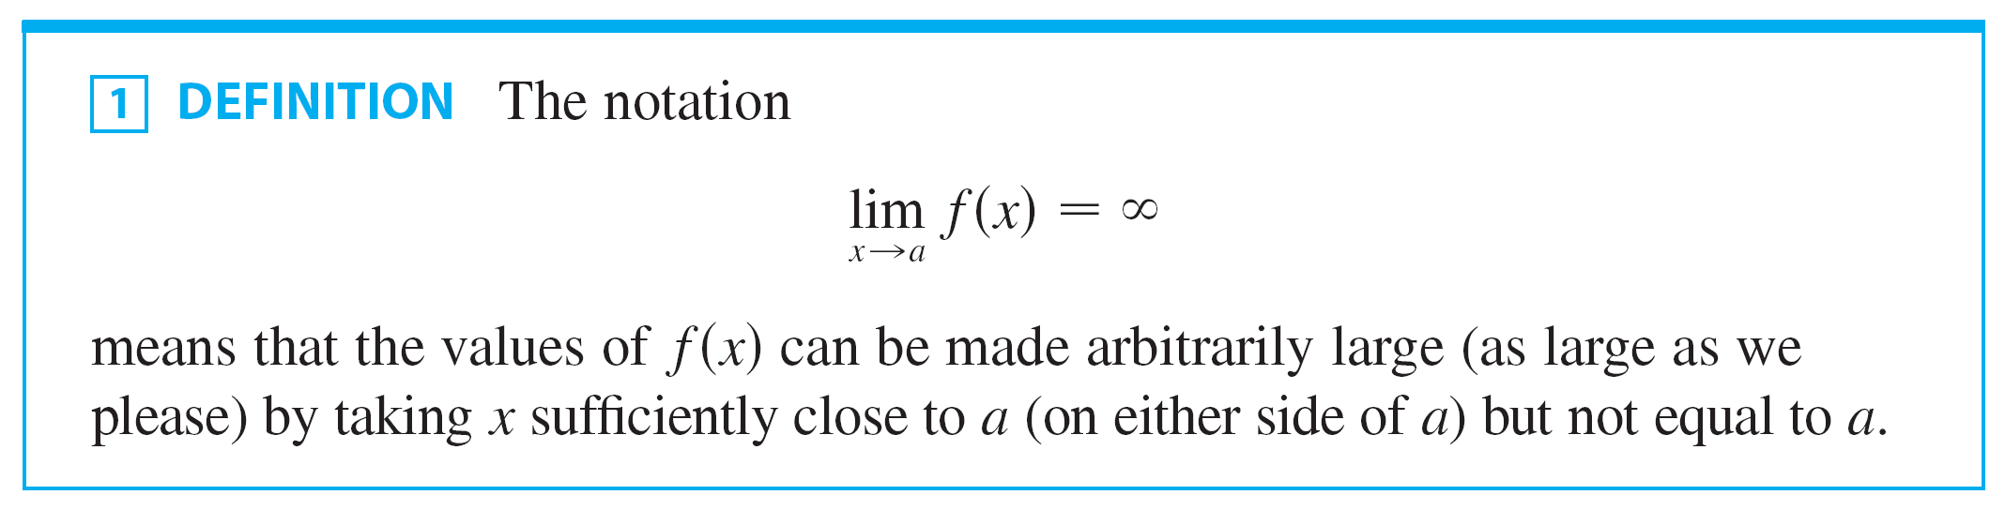
Definition 1

Slide 8


Infinite Limits
Another notation for is
Again, the symbol is not a number, but the expression is often read as
“the limit of f (x), as x approaches a, is infinity”
or “f (x) becomes infinite as x approaches a”
or “f (x) increases without bound as x approaches a”

Slide 9
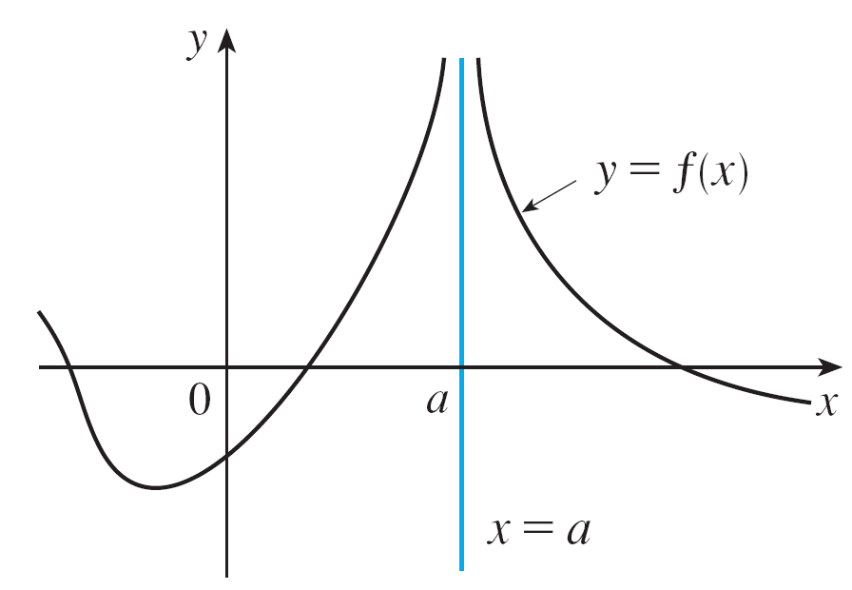
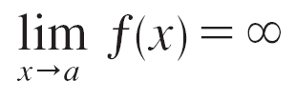
Infinite Limits
This definition is illustrated graphically in Figure 2.
Figure 2

Slide 10
Infinite Limits
Similarly, as shown in Figure 3,
That means that the values of f(x) are as large negative as we like for all values of x that are sufficiently close to a, but not equal to a.

Slide 11
Infinite Limits
The symbol can be read as “the limit of f(x), as x approaches a, is negative infinity” or “f(x) decreases without bound as x approaches a.”
As an example, we have:

Slide 12
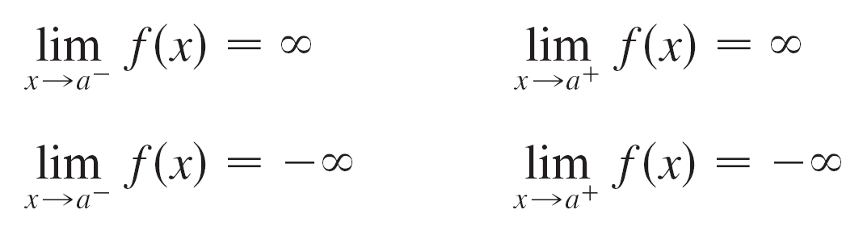
Infinite Limits
Similar definitions can be given for the one-sided infinite limits
remembering that “x → a–” means that we consider only values of x that are less than a, and similarly “x → a⁺” means that we consider only x > a.

Slide 13
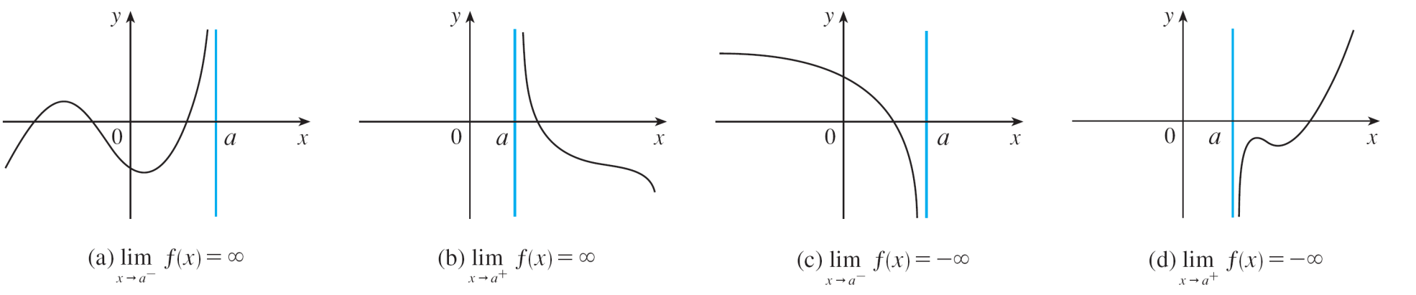
Infinite Limits
Illustrations of these four cases are given in Figure 4.
Figure 4

Slide 14
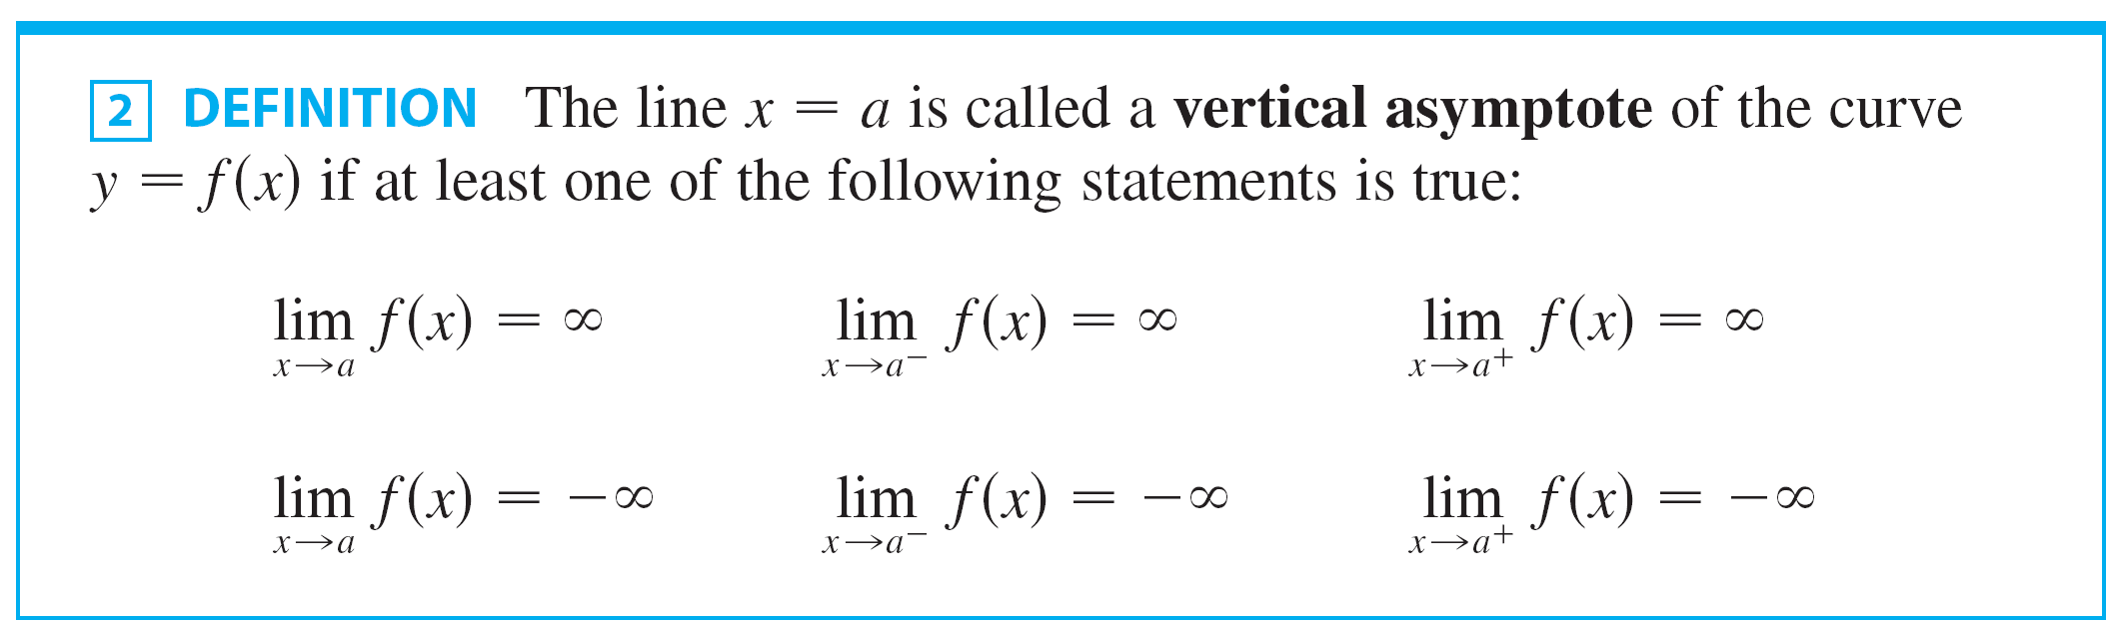

Definition 2
For instance, the y-axis is a vertical asymptote of the curve y = 1/x ² because

Slide 15
Example 1
Find and .
SOLUTION:
If x is close to 3 but larger than 3, then the denominator x – 3 is a small positive number and 2x is close to 6.
So, the quotient 2x/(x – 3) is a large positive number.
Thus, intuitively, we see that .

Slide 16
Example 1 – Solution
Likewise, if x is close to 3 but smaller than 3, then x – 3 is a small negative number but 2x is still a positive number (close to 6).
So, 2x/(x – 3) is a numerically large negative number.
Thus, we see that .

Slide 17
Example 1 – Solution
The graph of the curve y = 2x/(x – 3) is given in the figure.
The line x – 3 is a vertical asymptote.

Slide 18
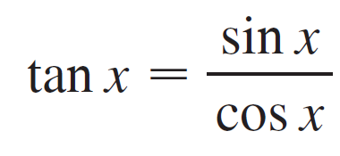
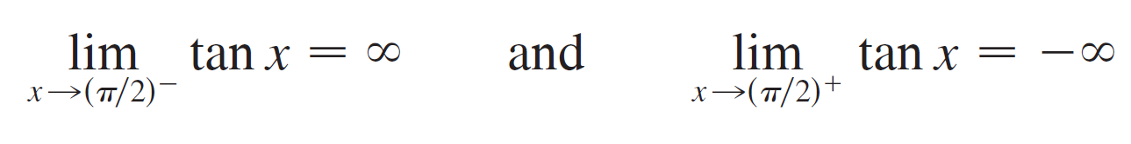
Example 2
Find the vertical asymptotes of f (x) = tan x.
Solution:
Because
there are potential vertical asymptotes where cos x = 0.
In fact, since cos x → 0⁺ as x → (π /2)– and cos x → 0– as x → (π /2)⁺ , whereas sin x is positive (and not near 0) when x is near π /2, we have

Slide 19
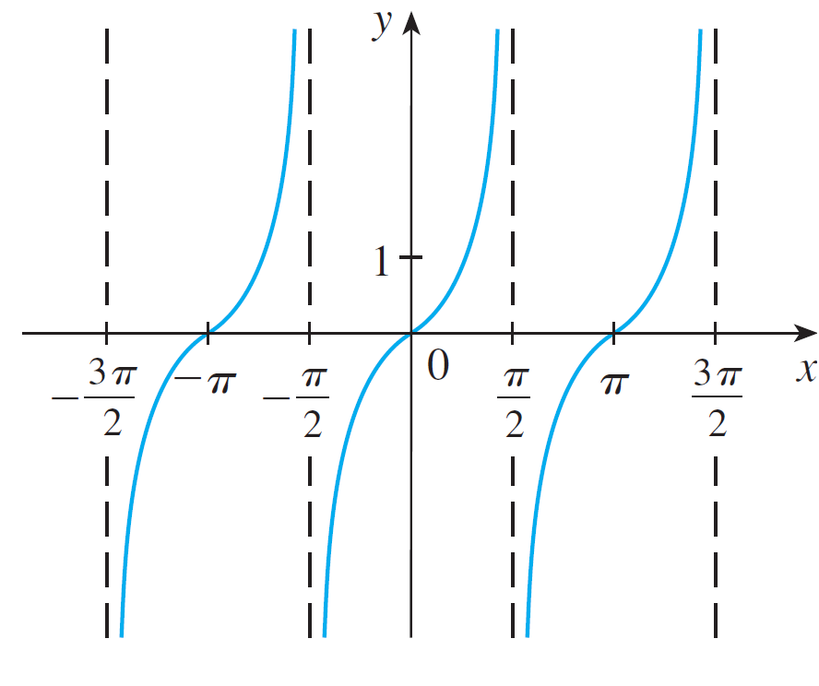
Example 2 – Solution
cont’d
This shows that the line x = π /2 is a vertical asymptote.
Similar reasoning shows that the lines x = (2n + 1)π /2, where n is an integer, are all vertical asymptotes of f (x ) = tan x. The graph in Figure 6 confirms this.
y = tan x
Figure 6

Slide 20
Limits At Infinity

Slide 21
LIMITS AT INFINITY
In computing infinite limits, we let x approach a number and the result was that the values of y became arbitrarily large (positive or negative). Here we let x become arbitrarily large (positive or negative) and see what happens to .

Slide 22
HORIZONTAL ASYMPTOTES
Let’s begin by investigating the behavior of the function f defined by as x becomes large.

Slide 23
HORIZONTAL ASYMPTOTES
The table gives values of this
function correct to six decimal
places. The graph of f has been
drawn by a computer in Figure 7.

Slide 24
HORIZONTAL ASYMPTOTES
As x grows larger and larger, you can see that the values of f(x) get closer and closer to 1.
It seems that we can make the values of f(x) as close as we like to 1 by taking x sufficiently large.

Slide 25
Limits At Infinity
This situation is expressed symbolically by writing
In general, we use the notation
to indicate that the values of f(x) approach L as x becomes larger and larger.

Slide 26
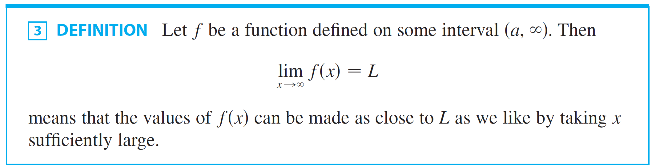
Definition 3

Slide 27
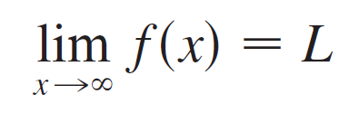

Limits AHORIZONTAL ASYMPTOTESt Infinity
Another notation for is
The symbol does not represent a number.
Nonetheless, the expression is often read as
“the limit of f(x), as x approaches infinity, is L”
or
“the limit of f(x), as x becomes infinite, is L”
or
“the limit of f(x), as x increases without bound, is L”

Slide 28
HORIZONTAL ASYMPTOTES
The meaning of such phrases is given by Definition 3.
A more precise definition, similar to the ε, δ definition of Section 1.3, is given at the end of this section.

Slide 29
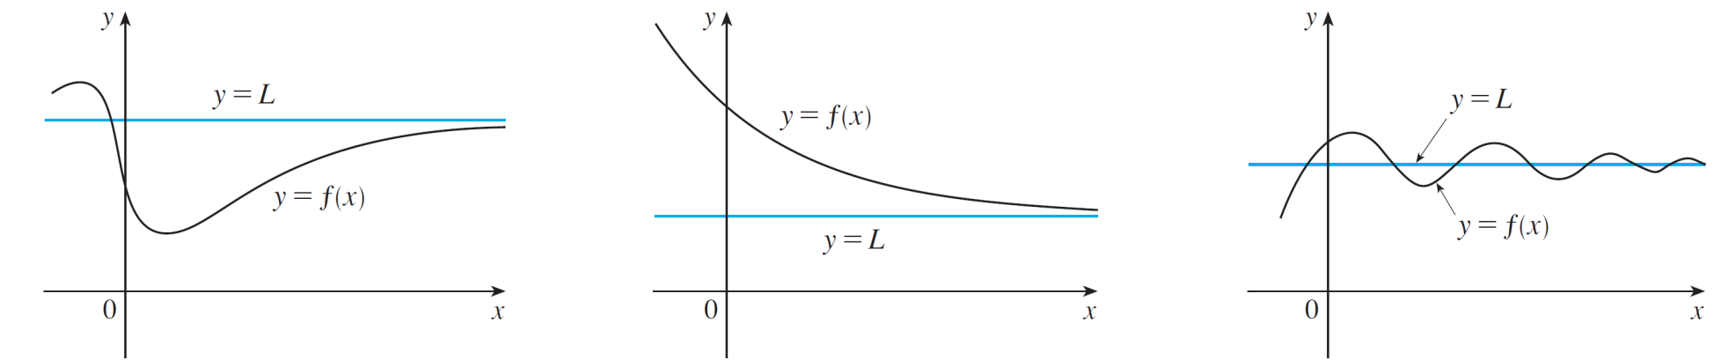
HORIZONTAL ASYMPTOTES
Geometric illustrations of Definition 3 are shown in Figure 8.
Notice that there are many ways for the graph of f to approach the line y = L (which is called a horizontal asymptote) as we look to the far right of each graph.
Examples illustrating
Figure 8

Slide 30
HORIZONTAL ASYMPTOTES
Referring to Figure 7, we see that, for numerically large negative values of x, the values of f(x) are close to 1.

Slide 31

HORIZONTAL ASYMPTOTES
By letting x decrease through negative values without bound, we can make f(x) as close as we like to 1.
This is expressed by writing $\lim_{x→−∞}{\frac{x^{2} −1}{x^{2}+1}=1}$

Slide 32
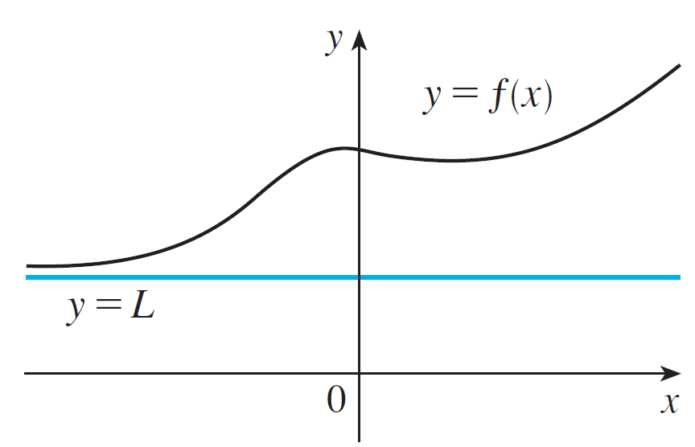
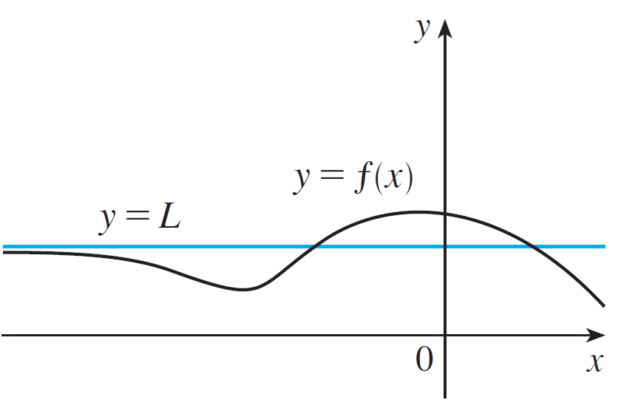

HORIZONTAL ASYMPTOTES
In general, as shown in Figure 9, the notation means
that the values of f(x) can be made arbitrarily close to L by taking x sufficiently large negative.
Figure 9

Slide 33

HORIZONTAL ASYMPTOTES
Again, the symbol does not represent a number, but the expression is often read as
the limit of f(x), as x approaches negative infinity, is L”

Slide 34
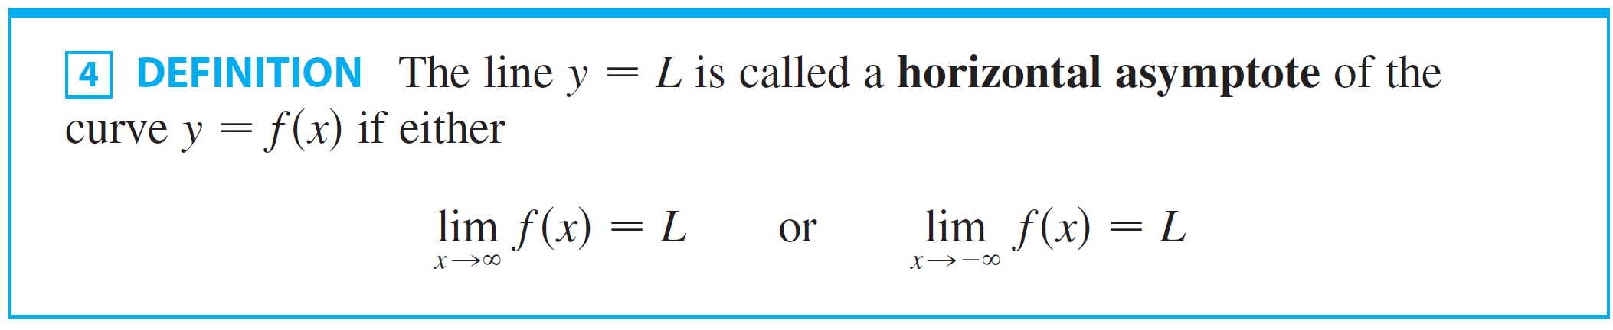
Definition 4

Slide 35
HORIZONTAL ASYMPTOTES
For instance, the curve illustrated in Figure 7 has the line y = 1 as a horizontal asymptote because

Slide 36
HORIZONTAL ASYMPTOTES
The curve y = f(x) sketched here has both y = -1 and y = 2 as horizontal asymptotes.
This is because

Slide 37
Example 3
Find the infinite limits, limits at infinity, and asymptotes for the function f whose graph is shown in Figure 11.

Slide 38
Example 3 – Solution
We see that the values of f(x) become large as from both sides. So,

Slide 39
Example 3 – Solution
Notice that f(x) becomes large negative as x approaches 2 from the left, but large positive as x approaches 2 from the right.
So,
Thus, both the lines x = – 1 and x = 2 are vertical asymptotes.

Slide 40
Example 3 – Solution
As x becomes large, it appears that f(x) approaches 4. However, as x decreases through negative values, f(x) approaches 2.
So, and
This means that both y = 4 and y = 2 are horizontal asymptotes.

Slide 41
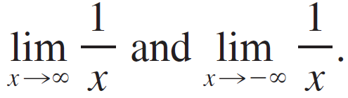
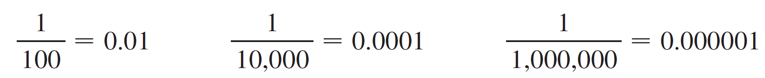
Example 4
Find
SOLUTION:
Observe that when x is large, 1/x is small.
For instance,
In fact, by taking x large enough, we can make 1/x as close to 0 as we please.

Slide 42
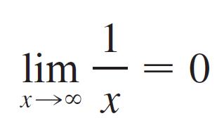
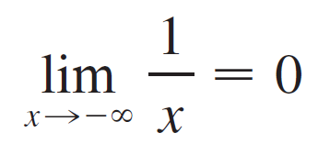
Example 4 – Solution
Therefore, according to Definition 3, we have
Similar reasoning shows that when x is large negative, 1/x is small negative, so we also have

Slide 43
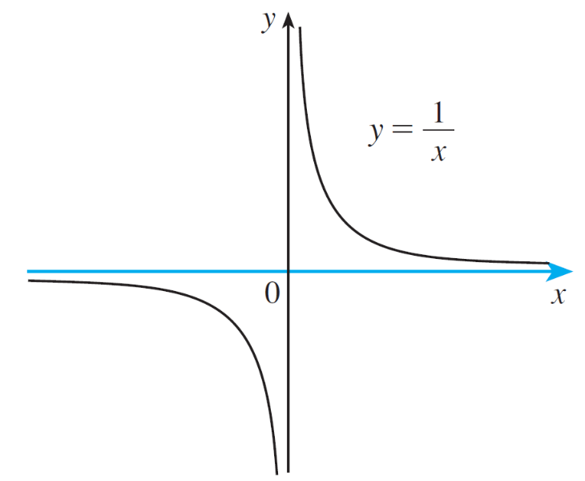
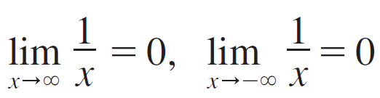
Example 4 – Solution
cont’d
Figure 12
It follows that the line y = 0(the x-axis) is a horizontal asymptote of the curve y = 1/x. (This is an equilateral hyperbola; see Figure 12.)

Slide 44
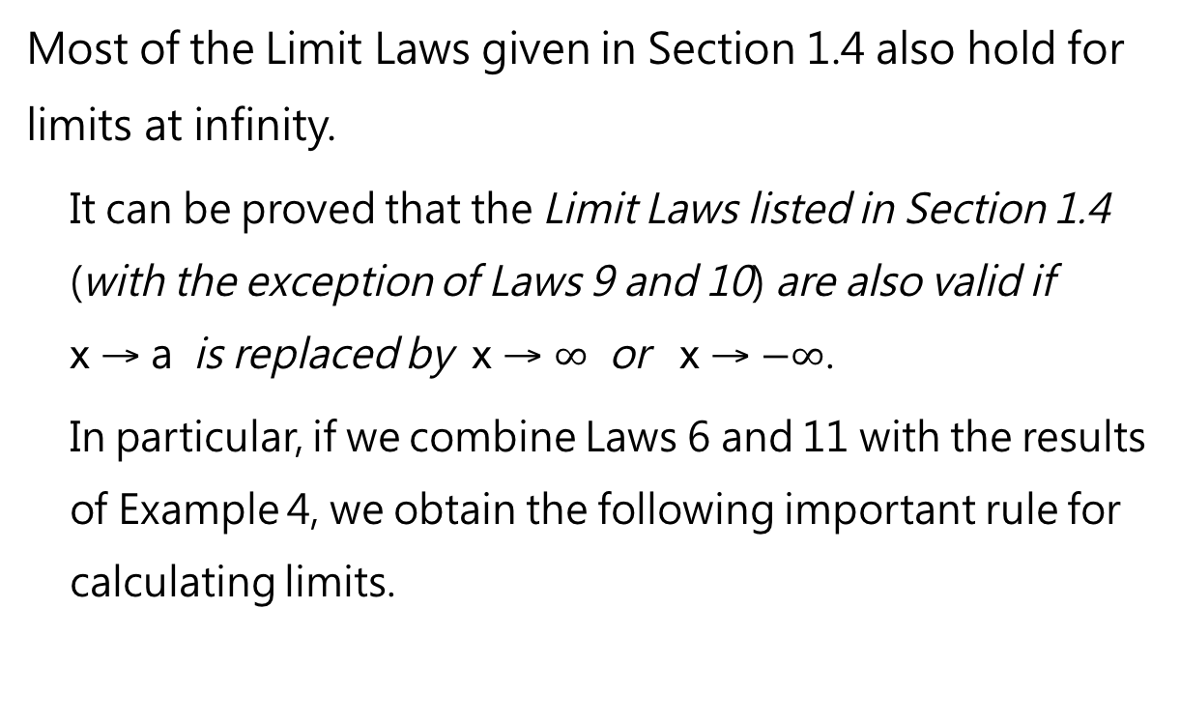
HORIZONTAL ASYMPTOTES
Most of the Limit Laws given in Section 1.4 also hold for limits at infinity.
It can be proved that the Limit Laws listed in Section 1.4 (with the exception of Laws 9 and 10) are also valid if x →a is replaced by x → $∞$ or x →$−∞$.
In particular, if we combine Laws 6 and 11 with the results of Example 4, we obtain the following important rule for calculating limits.

Slide 45
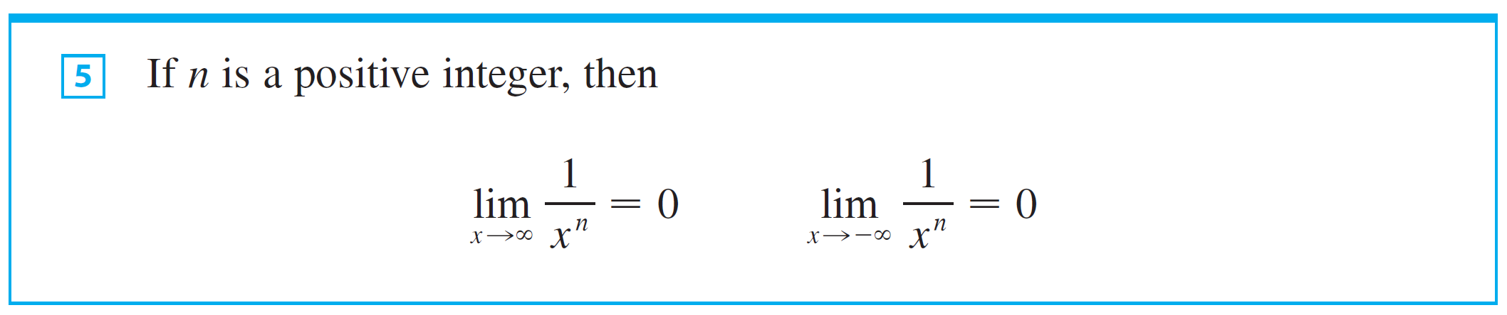
HORIZONTAL ASYMPTOTES
Following is the important rule for calculating limits.

Slide 46
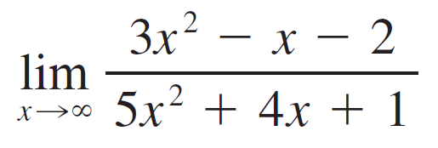
Example 5
Evaluate
SOLUTION:
As x becomes large, both numerator and denominator become large, so it isn’t obvious what happens to their ratio. We need to do some preliminary algebra.
To evaluate the limit at infinity of any rational function, we first divide both the numerator and denominator by the highest power of x that occurs in the denominator. (We may assume that x ≠ 0, since we are interested only in large values of x.)

Slide 47
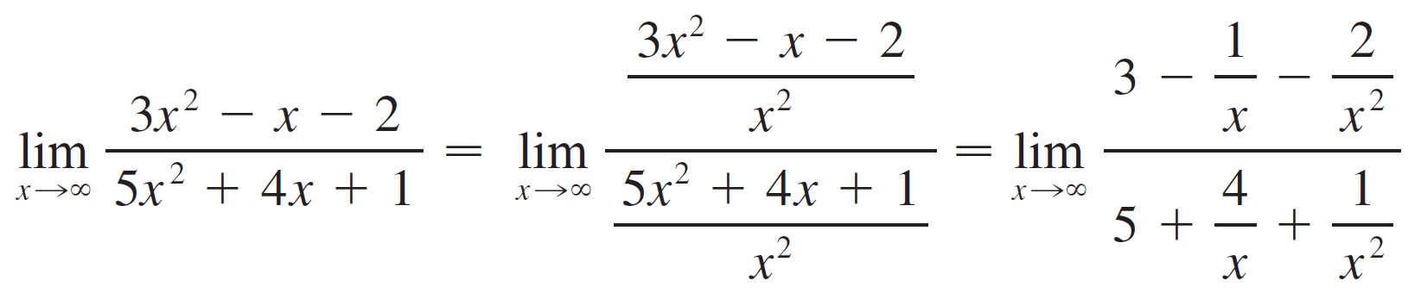
Example 5 – Solution
In this case the highest power of x is x², and so, using the Limit Laws, we have

Slide 48
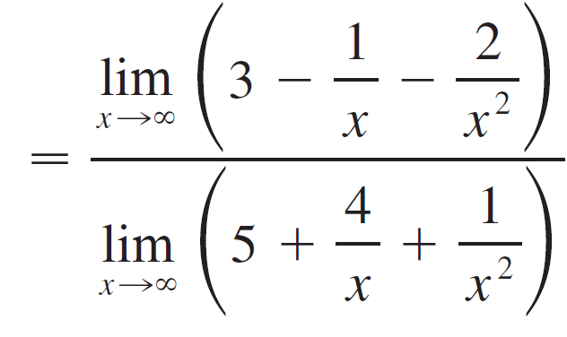
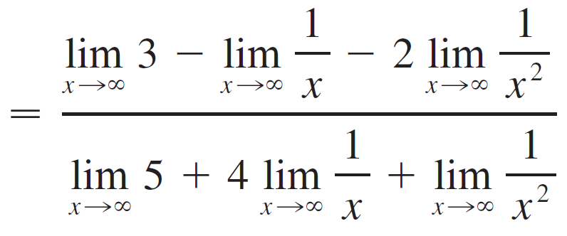
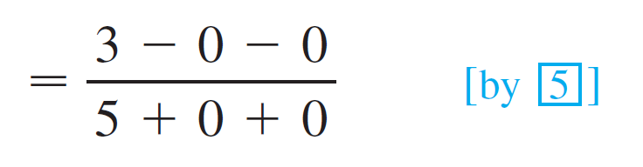
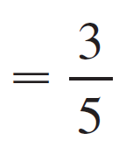
Example 5 – Solution

Slide 49

Example 5 – Solution
A similar calculation shows that the limit as x → is also
The figure illustrates the results of these calculations by showing how the graph of the given rational function approaches the horizontal asymptote.

Slide 50
Example 6
Compute
SOLUITON:
As both and x are large when x is large, it’s difficult to see what happens to their difference.
So, we use algebra to rewrite the function.

Slide 51
Example 6 – Solution
We first multiply the numerator and denominator by the conjugate radical:
The Squeeze Theorem could be used to show that this limit is 0.

Slide 52
Example 6 – Solution
However, an easier method is to divide the numerator and denominator by x.
Doing this and using the Limit Laws, we obtain:

Slide 53
Example 6 – Solution
Figure 14 illustrates this result.

Slide 54
Example 7
Evaluate
SOLUTION:
If we let t = 1/x, then as .
Therefore, .

Slide 55
Example 8
Evaluate
SOLUTION:
As x increases, the values of sin x oscillate between 1 and -1 infinitely often.
So, they don’t approach any definite number.
Thus, does not exist.

Slide 56
Infinite Limits At Infinity

Slide 57
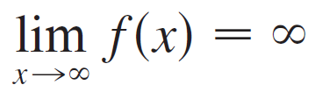
Infinite Limits At Infinity
The notation
is used to indicate that the values of f(x) become large as x becomes large.
Similar meanings are attached to the following symbols:

Slide 58

Example 9
Find
SOLUTION:
When x becomes large, x³ also becomes large.
For instance,
In fact, we can make x³ as big as we like by taking x large enough.

Slide 59
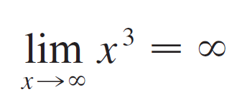
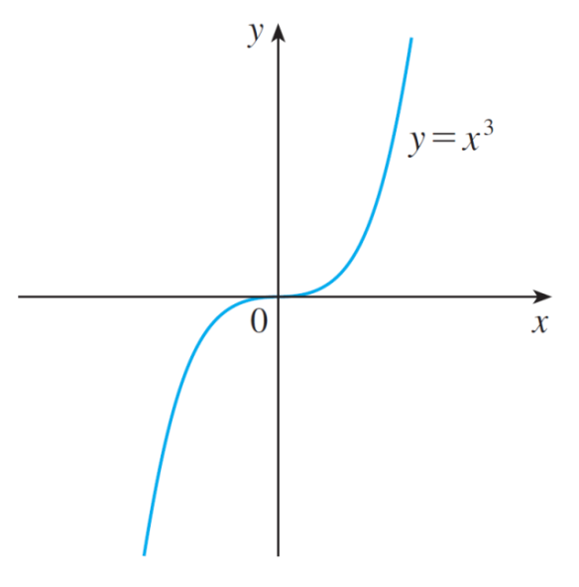
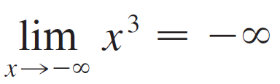
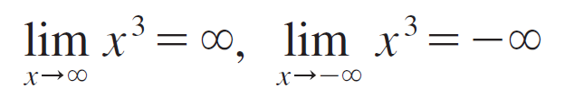
Example 9 – Solution
cont’d
Therefore we can write
Similarly, when x is large negative, so is x ³.
Thus
These limit statements can also be seen from the graph of y = x³ in Figure 15.
Figure 15

Slide 60
Example 10
Find
SOLUTION
It would be wrong to write
The Limit Laws can’t be applied to infinite limits because ∞ is not a number (∞ – ∞ can’t be defined).
However, we can write
This is because both x and x – 1 become arbitrarily large.

Slide 61
Example 11
Find
SOLUTION
We divide the numerator and denominator by the highest power of x in the denominator, which is just x:
because and as

Slide 62
Precise Definitions

Slide 63
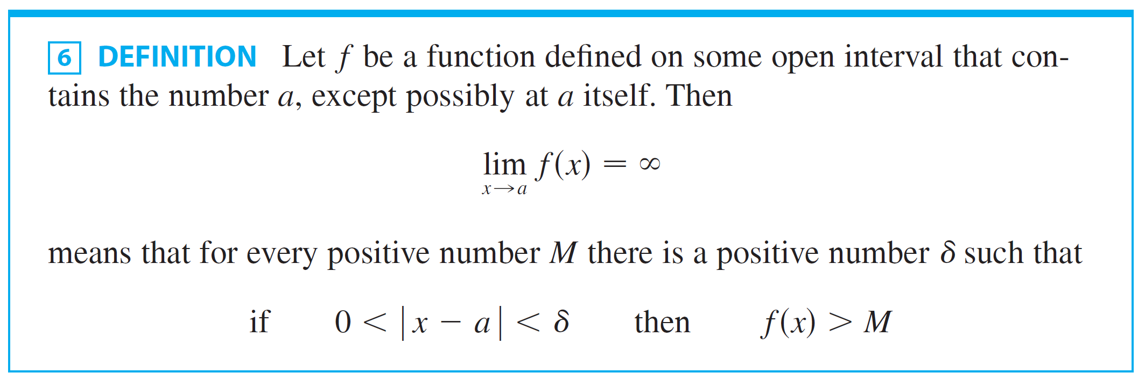
Precise Definitions
The following is a precise version of Definition 1.
This says that the values of f(x) can be made arbitrarily large (larger than any given number M) by taking x close enough to a (within a distance δ, where δ depends on M, but with x ≠ a).

Slide 64
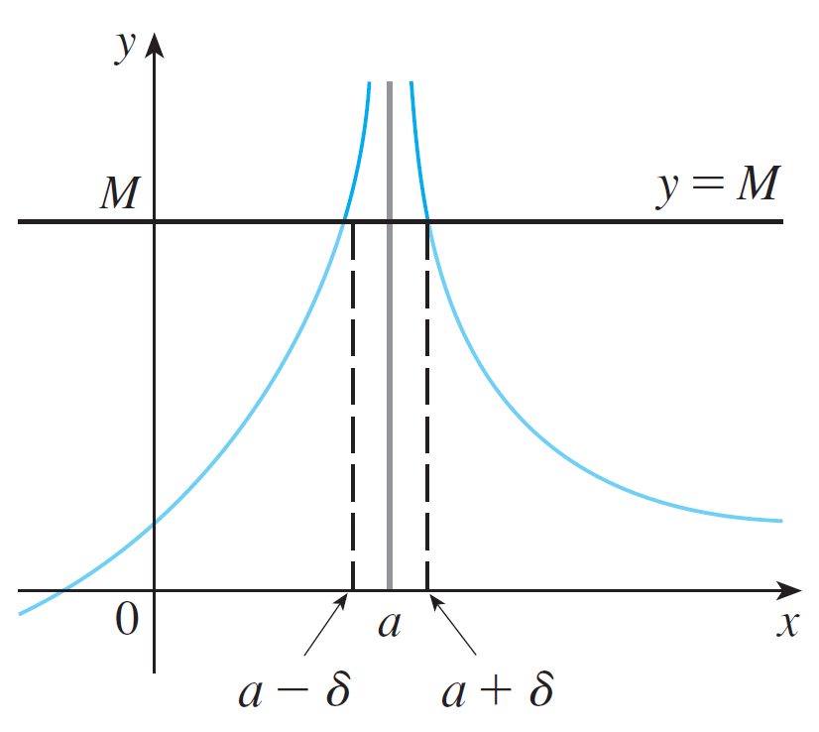
Precise Definitions
A geometric illustration is shown in Figure 16.
Given any horizontal line y = M, we can find a number δ > 0 such that if we restrict x to lie in the interval (a – δ, a + δ) but x ≠ a, then the curve y = f(x) lies above the line y = M.
You can see that if a larger M is chosen, then a smaller δ may be required.
Figure 16

Slide 65
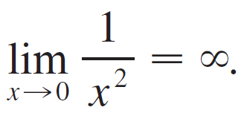
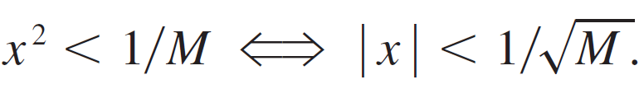
Example 12
Use Definition 6 to prove that
SOLUTION:
Let M be a given positive number. According to Definition 6, we need to find a number δ such that
But

Slide 66
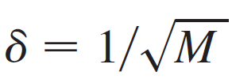
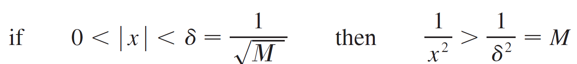
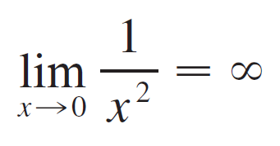
Example 12 – Solution
We can choose because
Therefore, by Definition 6,

Slide 67
PRECISE DEFINITIONS
Similarly, means that for every negative number N there is a positive number δ such that if , then .
Definition 3 can be stated precisely as follows.

Slide 68
Definition 7
Let f be a function defined on some interval (a, ∞). Then means that, for every , there is a corresponding number N such that if x > N then

Slide 69
PRECISE DEFINITIONS
In words, this says that the values of f(x) can be made arbitrarily close to L (within a distance,
where ε is any positive number) by taking x sufficiently large (larger than N, where N depends on ε).

Slide 70
PRECISE DEFINITIONS
Graphically, it says that, by choosing x large enough (larger than some number N), we can make the graph of f lie between the given horizontal lines y = L – ε and y = L + ε
This must be true no matter how small we choose ε.

Slide 71
PRECISE DEFINITIONS
Figure 18 shows that, if a smaller value of ε is chosen, then a larger value of N may be required.
.

Slide 72
PRECISE DEFINITIONS
Similarly, means that for every ε > 0 there is a corresponding number such that if , then .

Slide 73
Example 13
Use Definition 7 to prove
SOLUTION:
Given ε > 0, we want to find N such that
if x > N, then
In computing the limit, we may assume that x > 0
Then,

Slide 74
Example 13 – Solution
Let’s choose
So, if , then
Therefore, by Definition 7,

Slide 75
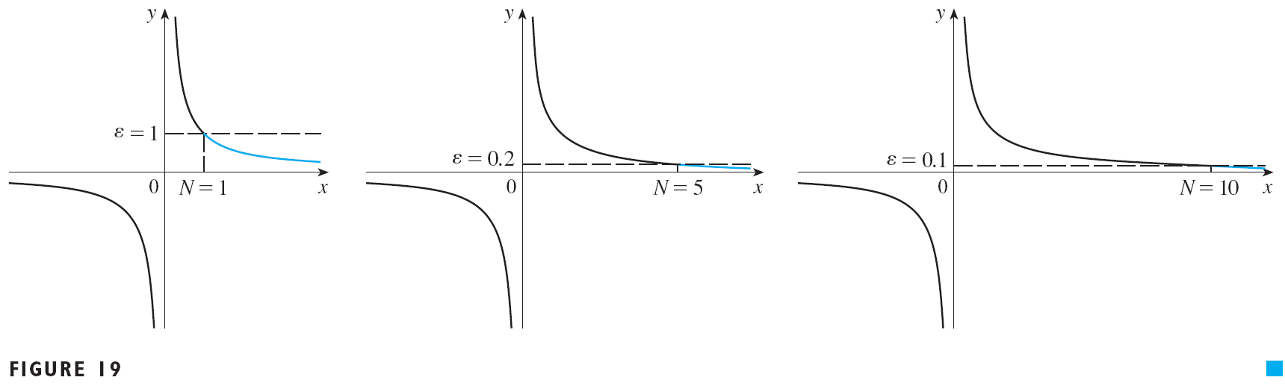
Example 13 – Solution
Figure 19 illustrates the proof by showing some values of ε and the corresponding values of N.

Slide 76
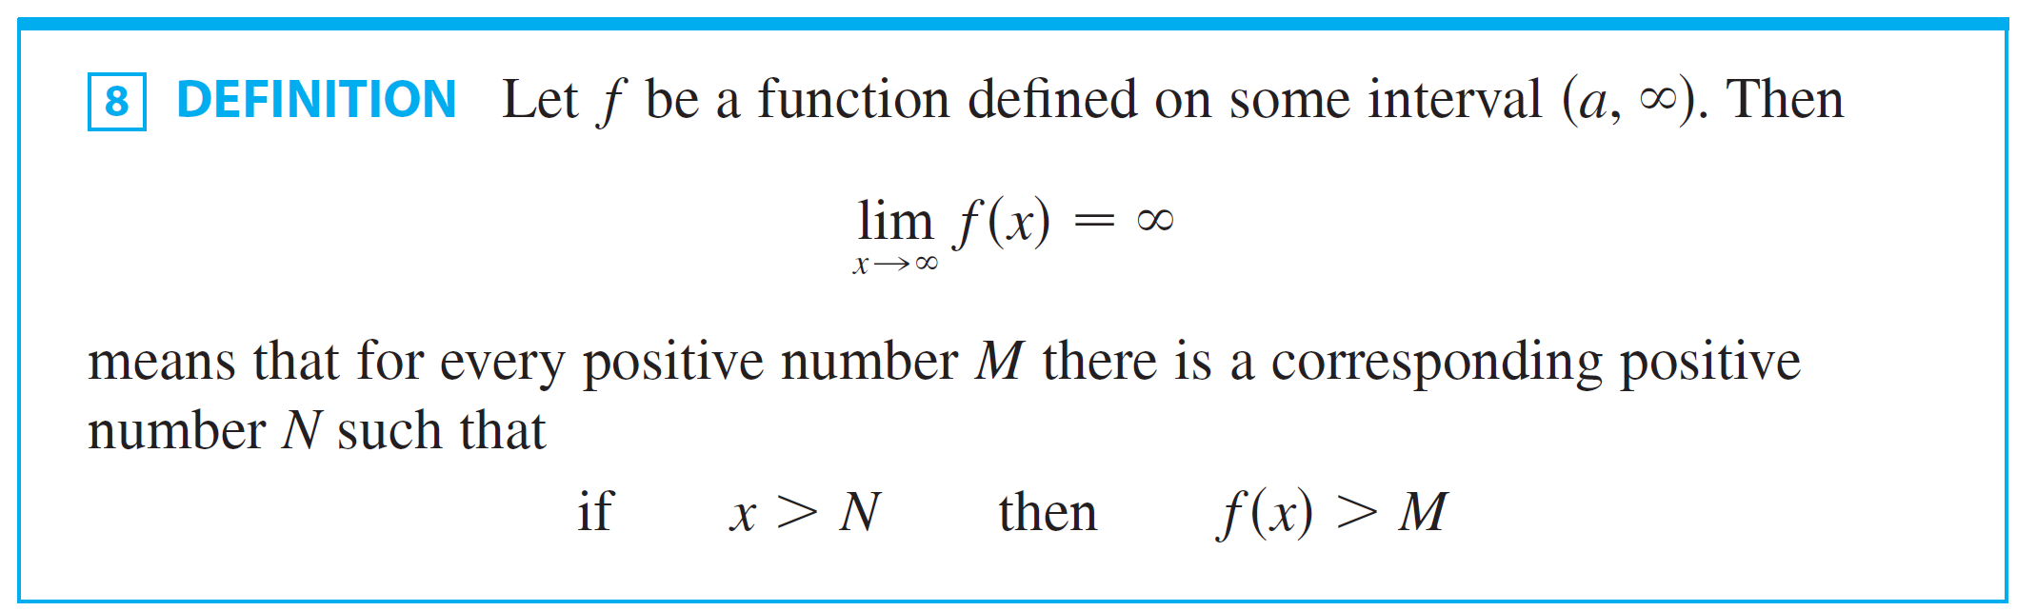
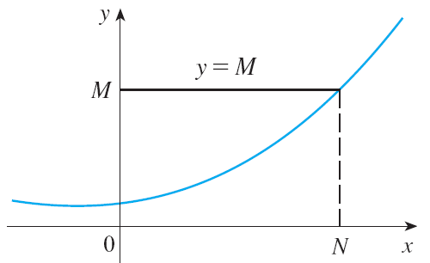
Precise Definitions
Similar definitions apply when the symbol is replaced by .

